Slide 1
CS 570: Data Structures
Stack Implementation in Java

Slide 2
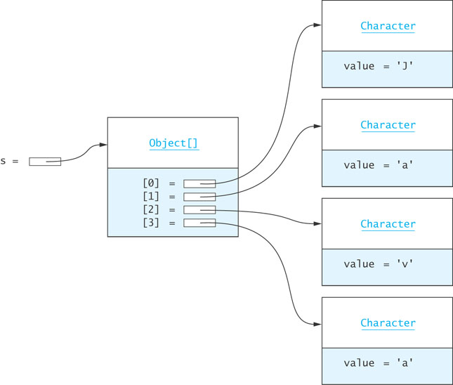
Implementing a Stack as an Extension of Vector
The Java API includes a Stack class as part of the package java.util :
public class Stack<E> extends Vector<E>
The Vector class implements a growable array of objects
Elements of a Vector can be accessed using an integer index and the size can grow or shrink as needed to accommodate the insertion and removal of elements

Slide 3
Implementing a Stack as an Extension of Vector (cont.)
We can use Vector's add method to implement push:
public E push(obj E) {
add(obj);
return obj;
}
pop can be coded as
public E pop() throws EmptyStackException {
try {
return remove (size() – 1);
} catch (ArrayIndexOutOfBoundsException ex) {
throw new EmptyStackException();
}
}

Slide 4
Implementing a Stack as an Extension of Vector (cont.)
Because a Stack is a Vector, all of Vector operations can be applied to a Stack (such as searches and access by index)
But, since only the top element of a stack should be accessible, this violates the principle of information hiding
Notes:
does that remind us of something? Ordered list application with use of linkedlist.

Slide 5
Implementing a Stack with an ArrayList Component
As an alternative to a stack as an extension of Vector, we can write a class, ListStack, that has a ArrayList component (in the example below, theData)
We can use either the ArrayList, Vector, or the LinkedList classes, as all implement the List interface. The push method, for example, can be coded as
public E push(E obj) {
theData.add(obj);
return obj;
}
A class which adapts methods of another class by giving different names to essentially the same methods (push instead of add) is called an adapter class
Writing methods in this way is called method delegation

Slide 6
Implementing a Stack Using an Array
If we implement a stack as an array, we would need . . .
public class ArrayStack<E> implements StackInt<E> {
private E[] theData;
int topOfStack = -1;
private static final int INITIAL_CAPACITY = 10;
@SupressWarnings("unchecked")
public ArrayStack() {
theData = (E[])new Object[INITIAL_CAPACITY];
}
Notes:
It is an annotation to suppress compile warnings about unchecked generic operations (not exceptions), such as casts.

Slide 7
Implementing a Stack Using an Array
If we implement a stack as an array, we would need . . .
public class ArrayStack<E> implements StackInt<E> {
private E[] theData;
int topOfStack = -1;
private static final int INITIAL_CAPACITY = 10;
@SupressWarnings("unchecked")
public ArrayStack() {
theData = (E[])new Object[INITIAL_CAPACITY];
}
Allocate storage for an array with a default capacity
Keep track of the top of the stack (subscript of the element at the top of the stack; for empty stack = -1)
We do not need a size variable or method

Slide 8
Implementing a Stack Using an Array (cont.)
Character
Object[]
value = 'J'
ArrayStack
[0] = null
[1] = null
[2] = null
[3] = null
[4] = null
[5] = null
[6] = null
[7] = null
[8] = null
[9] = null
Character
theData =
topOfStack = -1
3
0
1
2
value = 'a'
Character
value = 'v'
public E push(E obj) {
if (topOfStack == theData.length - 1){
reallocate();
}
topOfStack++;
theData[topOfStack] = obj;
return obj;
}
Character
value = 'a'

Slide 9
Implementing a Stack Using an Array (cont.)
@Override
public E pop() {
if (empty()) {
throw new EmptyStackException();
}
return theData[topOfStack--];
}
Notes:
Override: why here?
Additionally, in Java 1.6 you can use it to mark when a method implements an interface for the same benefits.
make the compiler check that the name, and arguments of the methods are the same.

Slide 10
Implementing a Stack Using an Array (cont.)
This implementation is O(1), since all insertions and deletions are at one end.

Slide 11
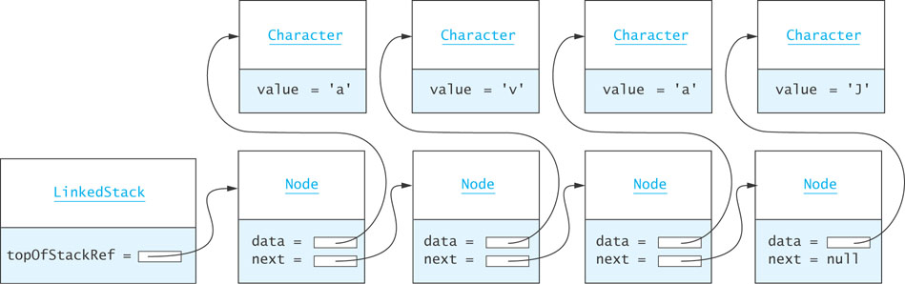
Implementing a Stack as a Linked Data Structure
We can also implement a stack using a linked list of nodes
It is easiest to insert and delete from the head of a list
push inserts a node at the head and pop deletes the node at the head
when the list is empty, pop returns null
Notes:
Is this better or using an array?

Slide 12
Implementing a Stack as a Linked Data Structure (cont.)
import java.util.EmptyStackException;
public class LinkedStack < E > implements StackInt < E > {
/** A Node is the building block for a single-linked list. */
private static class Node < E > {
// Data Fields
/** The reference to the data. */
private E data;
/** The reference to the next node. */
private Node next;

Slide 13
Implementing a Stack as a Linked Data Structure (cont.)
// Constructors
/** Creates a new node with a null next field.
@param dataItem The data stored
*/
private Node(E dataItem) {
data = dataItem;
next = null;
}
/** Creates a new node that references another node.
@param dataItem The data stored
@param nodeRef The node referenced by new node
*/
private Node(E dataItem, Node < E > nodeRef) {
data = dataItem;
next = nodeRef;
}
} //end class Node

Slide 14
Implementing a Stack as a Linked Data Structure (cont.)
// Data Fields
/** The reference to the first stack node. */
private Node < E > topOfStackRef = null;
/** Insert a new item on top of the stack.
post: The new item is the top item on the stack.
All other items are one position lower.
@param obj The item to be inserted
@return The item that was inserted
*/
public E push(E obj) {
topOfStackRef = new Node < E > (obj, topOfStackRef);
return obj;
}

Slide 15
Implementing a Stack as a Linked Data Structure (cont.)
/** Remove and return the top item on the stack.
pre: The stack is not empty.
post: The top item on the stack has been
removed and the stack is one item smaller.
@return The top item on the stack
@throws EmptyStackException if the stack is empty
*/
public E pop() {
if (empty()) {
throw new EmptyStackException();
}
else {
E result = topOfStackRef.data;
topOfStackRef = topOfStackRef.next;
return result;
}
}

Slide 16
Implementing a Stack as a Linked Data Structure (cont.)
/** Return the top item on the stack.
pre: The stack is not empty.
post: The stack remains unchanged.
@return The top item on the stack
@throws EmptyStackException if the stack is empty
*/
public E peek() {
if (empty()) {
throw new EmptyStackException();
}
else {
return topOfStackRef.data;
}
}

Slide 17
Implementing a Stack as a Linked Data Structure (cont.)
/** See whether the stack is empty.
@return true if the stack is empty
*/
public boolean empty() {
return topOfStackRef == null;
}
}
Notes:
Is this better or using an array?

Slide 18
Comparison of Stack Implementations
Extending a Vector (as is done by Java) is a poor choice for stack implementation, since all Vector methods are accessible
The easiest implementation uses a List component (ArrayList is the simplest) for storing data
An underlying array requires reallocation of space when the array becomes full, and
an underlying linked data structure requires allocating storage for links
As all insertions and deletions occur at one end, they are constant time, O(1), regardless of the type of implementation used

Slide 19
Implementation Recommendation
Some stack implementations used the java.util.Stack class, which is part of the original Java API not recommended for new applications.
Java designers recommend using java.util.Deque and java.util.ArrayDeque

